Slide 1
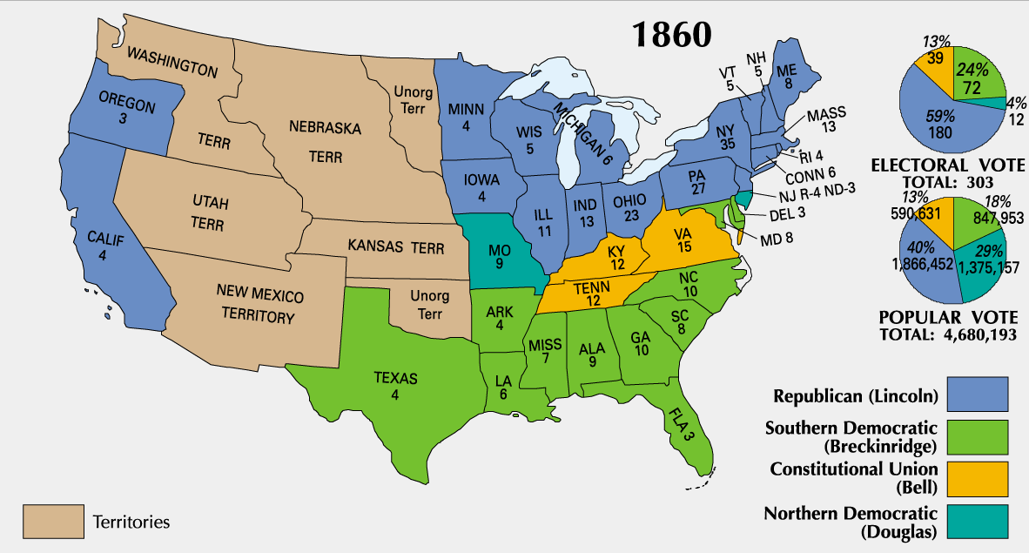
AIM: How did the strategies of the North and South affect the conduct and outcome of the Civil War?
Do Now:
Review the picture…
Why would the South
secede after the election
of 1860?
HW:
Chart
DBQ – Due 12/6

Slide 2
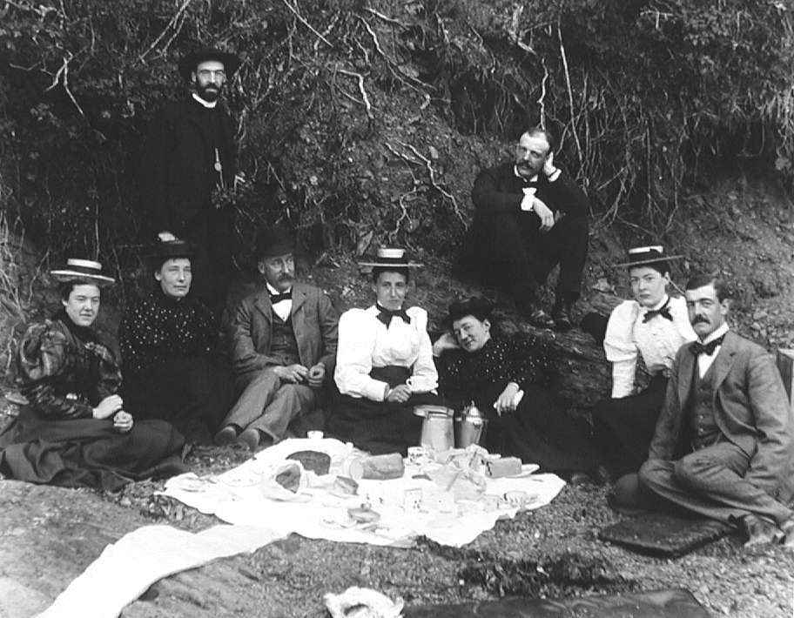
What do you see in this picture?
Where do you think these people were?

Slide 3
The North and South during the Civil War…who had what?
Directions: Using the map found on the class website, answer the following questions (http://www.teachingamericanhistory.org/neh/interactives/civilwar/lesson1/)
Who had most of the railroads?
Where was most of the slave population?
Where did most of the free blacks live?
Where was most of the crop production?
Where was most of the industry?

Slide 4
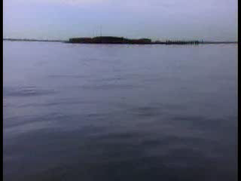
Fort Sumter (Video)
In March of 1861, a small group of _______________ troops sought refuge in a fort in South Carolina. This fort was known as Fort ______________ and was located in Charleston Harbor. In order to resupply the fort and the federal troops there, President ____________ decided to send in a __________ to conserve federal power.
Jefferson Davis, the President of the Confederacy was also deciding what to do about the Federal troops at the fort because he knew they were running out of ______________. He had the fort attacked and the federal troops were forced to ____________. The Civil War between the North and the South had __________.
This marked the beginning of the Civil War.

Slide 5
Strategies used during the Civil War
Directions: Use the following slides to complete the chart in your notes.
NORTH | SOUTH
Writ of Habeas Corpus - is the legal protection requiring that a court determine if a person is lawfully imprisoned. It was suspended during the Civil War. Without it, people can be held in jail for indefinite periods of time without being charged with a crime. During the war, 13,000 Americans who objected to the Union government’s policies were imprisoned without trial – i.e. newspaper editors, state officials, and Southern sympathizers.

Slide 6
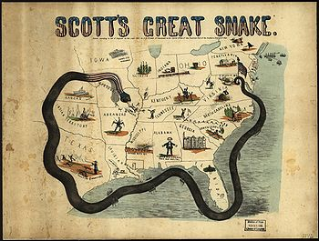
The North…Anaconda Plan What did the North do to the South? Why is this an advantage?

Slide 7
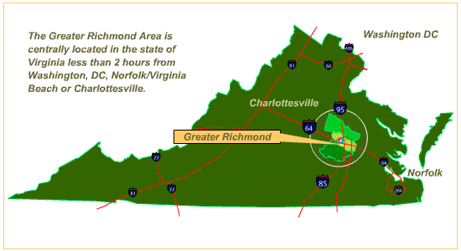
The North… What did the North do to the Confederacy’s capitol city? Why was this a good strategy?

Slide 8
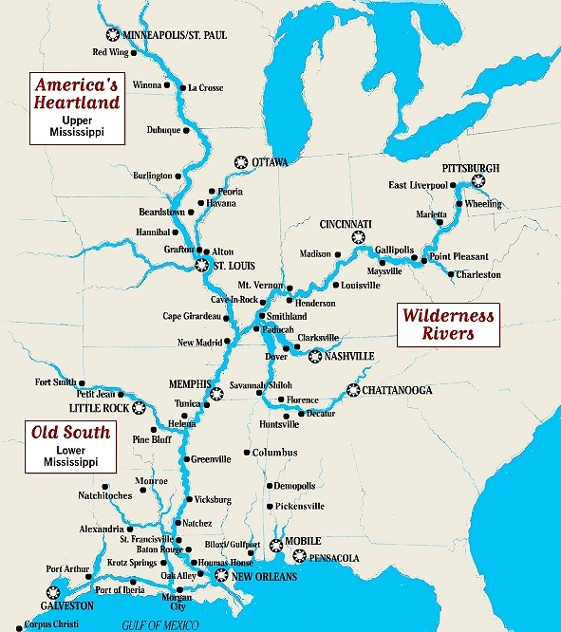
The North…divide and conquer The North looked to take over the Confederacy one piece at a time, eventually controlling all of the Mississippi.

Slide 9
The North…
Lincoln suspended the Writ of Habeas Corpus..
Habeas Corpus is the legal protection requiring that a court determine if a person is lawfully imprisoned
Without it, people can be held in jail for indefinite periods of time without being charged with a crime
During the war, 13,000 Americans who objected to the Union government’s policies were imprisoned without trial – i.e. newspaper editors, state officials, and Southern sympathizers

Slide 10
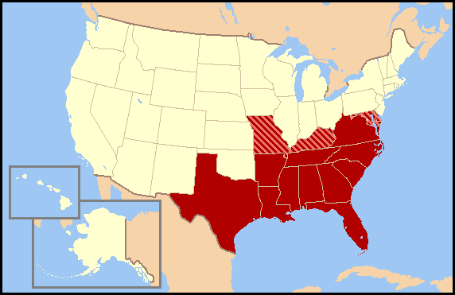
The South…was fighting a defensive war

Slide 11
The South begain to attack towards…

Slide 12
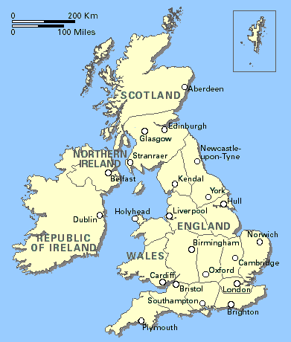
The South…
Please help us!

Slide 13
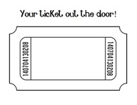
EXIT Ticket…to be handed in…

